Slide 1
ER(Emergency Room) Simulator
By: Kevin Luu - 300789868
Will Zhang - 300794888
Sangbeom (Sean) Yi - 300857600

Slide 2

Premise
3-4 types of patients showed in different colors which present how badly they hurt or how sick they are.
Green to Yellow to Red.
The red patients will cut the line because they need immediate treatment, greens will become yellow after waiting for too long.
We can adjust the numbers of doctors or nurses while it’s running to observe the changes.
Mild
Poor
Severe

Slide 3
Original System
ER Rooms are mostly unpredictable, with varying amounts of people coming in during the course of a day.
We need to understand how a patient moves around an ER Room
When unorganized, a line for the ER could take a very long time.

Slide 4

Why are we making this simulation?
To understand the flow of patients
How we can reduce wait times in hospitals

Slide 5
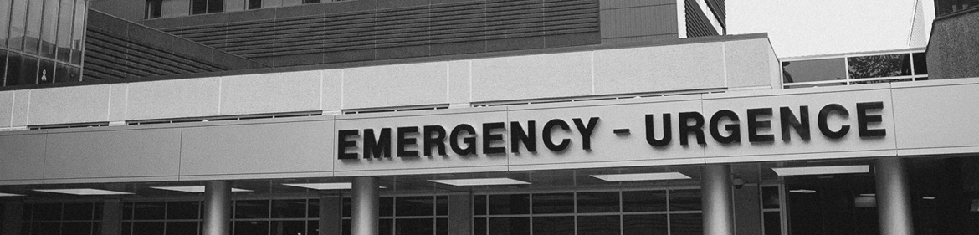
Conceptual Model
When completed, our simulation should be able to emulate
A workflow from when a patient enters the ER, until they leave
Movement of staff and patients
How certain occurrences will affect the workflow

Slide 6





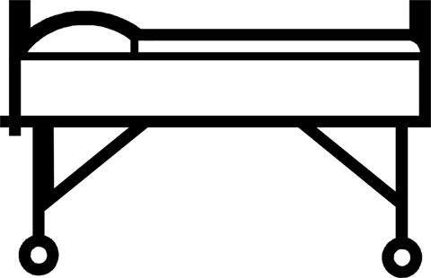

Workflow
t
First Aid
Admission
EXIT
EXIT
Treatment
EXIT
or
Send to other ER
Phase 1
Phase 2

Slide 7
Observable Elements
Stamina
Treating someone?
Doctor
Stamina
Treating someone?
Nurse
Stamina
Waiting Time
Emergency Type
Bleeding?
Patient
Bed
Occupied?
ER Room

Slide 8
Slider Options (Definition Parameter)
Number of patients
Number of doctors
Number of nurses
Amount of ER Bed
Occupancy of the waiting room
Partient
20
pp. / hr
Doctor
4
Nurse
6
ER Bed
20
ea.
Waiting Room
for
40
pp.

Slide 9
ER Simulation UML
Hospital Stuffs
Patients
- doctorsNum : int - nursesNum : int - beds : int
- patientType: int
- patientID: int
- Timer: double
+ firstaid() + treatment()
+ beds() return bool
+ waitTooLong()
+ getTreatment()
Cubicle
- bedAvailable: bool
- nurseAvailable: bool
- docAvailable: bool
- bedNum: int
Stastics
Waiting Room
+ treatment()
- timeInQueue: double
- waitTime: double
- queue: int[]array
- waitingForDoc: double
- waitingForNurse: double
- watingForBed:double
+ calculateQTime()
+ CalCubicleBlockage()
+patientTypeChange()

Slide 10
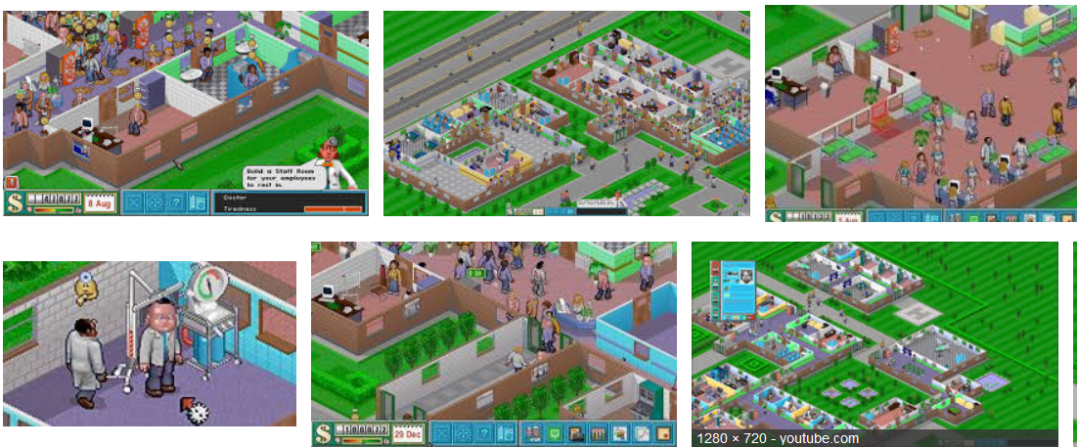
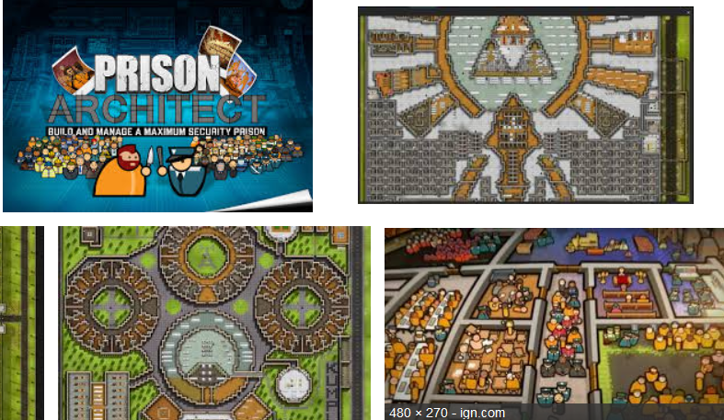
Refs Screenshot
Theme hospital:
Prison Architect:

Slide 11
Refs
Theme hospital: https://www.google.ca/search?q=theme+hospital&espv=2&biw=1920&bih=974&source=lnms&tbm=isch&sa=X&ved=0ahUKEwjCvLqwpODRAhUBWWMKHSr3ADEQ_AUIBigB&dpr=1
Prison Architect: https://www.google.ca/search?q=prison+architect&espv=2&biw=1920&bih=974&source=lnms&tbm=isch&sa=X&ved=0ahUKEwjky_ScpODRAhVO8WMKHXRiDT8Q_AUIBygC#imgdii=tY7Q485lLlOEWM%3A%3BtY7Q485lLlOEWM%3A%3B3zfS4nrXLA1aDM%3A&imgrc=tY7Q485lLlOEWM%3A
Simulation Refs. https://gallery.shinyapps.io/EDsimulation/ http://www.yousimul8.com/watch.php?x=4c84fbc5e11e0

Slide 12

Q & A
Thank you!

